Slide 1
Electromagnetic Induction
Chapter 31
Faraday’s Law
Notes:
1

Slide 2
Electromagnetic Induction
A changing magnetic field (intensity, movement)
will induce an electromotive force (emf)
In a closed electric circuit,
a changing magnetic field
will produce an electric current

Slide 3
Electromagnetic Induction
Faraday’s Law
The induced emf in a circuit is proportional to the rate of change
of magnetic flux, through any surface bounded by that circuit.
ε = - dΦ_{B} / dt

Slide 4
Faraday’s Experiments
N
S
v
I
Michael Faraday discovered induction in 1831.
Moving the magnet induces a current I.
Reversing the direction reverses the current.
Moving the loop induces a current.
The induced current is set up by an induced EMF.
Notes:
2

Slide 5
Faraday’s Experiments
(left)
(right)
dI/dt
EMF
I
S
Changing the current in the right-hand coil induces
a current in the left-hand coil.
The induced current does not depend on the size of
the current in the right-hand coil.
The induced current depends on dI/dt.
Notes:
3

Slide 6
Magnetic Flux
A
B
In the easiest case, with a constant magnetic field B, and a flat surface of area A, the magnetic flux is
Φ_{B} = B · A
Units : 1 tesla x m² = 1 weber
Notes:
3

Slide 7
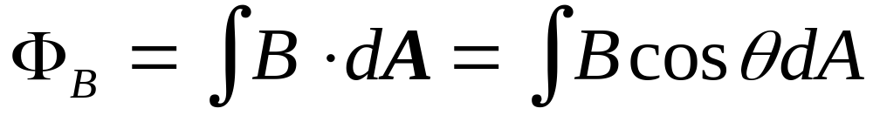
Magnetic Flux
B
S
N
dA
θ
B
When B is not constant, or the surface is not flat, one must
do an integral.
Break the surface into bits dA. The flux through one bit is
dΦ_{B} = B · dA = B dA cosθ.
Add the bits:
.
Notes:
4

Slide 8
Faraday’s Law
1)
N
S
2)
di/dt
EMF
v
i
i
S
Moving the magnet changes the flux Φ_{B} (1).
Changing the current changes the flux Φ_{B} (2).
Faraday: changing the flux induces an emf.
  ε = - dΦ_{B} /dt
Faraday’s law
The emf induced around a loop
equals the rate of change
of the flux through that loop
Notes:
5

Slide 9
Lenz’s Law
Faraday’s law gives the direction of the induced emf and therefore the direction of any induced current.
Lenz’s law is a simple way to get the directions straight, with less effort.
Lenz’s Law:
  The induced emf is directed so that any induced current flow
  will oppose the change in magnetic flux (which causes the
  induced emf).
This is easier to use than to say ...
Decreasing magnetic flux ⇒ emf creates additional magnetic field
Increasing flux ⇒ emf creates opposed magnetic field

Slide 10
Lenz’s Law
B
N
B∗
S
v
I
If we move the magnet towards the loop
the flux of B will increase.
Lenz’s Law ⇒ the current induced in the
loop will generate a field B∗ opposed to B.
Notes:
2

Slide 11
Lenz’s Law
B
N
B∗
S
v
I
If we move the magnet towards the loop
the flux of B will increase.
Lenz’s Law ⇒ the current induced in the
loop will generate a field B∗ opposed to B.
Notes:
2

